Slide 1

TUN Data Challenge
Group 7 (Andrew Rock, Stone Frangowlakis, Jacob Alderman, Madison Land, Daniela Quiroga)
INFO 320

Slide 2

Problem and Motivation
Is there a relationship between a client's demographic profile (rank, branch, time in service, spouse status etc.) and a client's likelihood to complete a survey?
Surveys are important for all businesses for feedback on their service. Hire Heroes request each customer to complete a survey when they have found employment. Our goal is to analyze the data to see if demographics have a say in survey completion. If they do, this data will better assist Hire Heroes in targeting those who do not complete the survey with reminders, incentives, etc.

Slide 3


Summary/Approach
Determine necessary datasets
Utilize Tableau Prep to clean datasets
Null values
Excess columns
Create various decision tree models using Knime to see what are the key determinants of survey completion
Use Tableau to visualize the data
Race
Branch of Service
Employment Status
Education
Notes:
Necessary datasets:
Salesforce Survey Demographic and Feedback
Tableau Prep: identify which populations completed a survey, normalized the values, removed excess columns

Slide 4

Tools and Analytics
Tableau, Tableau Prep, and Knime were used.
Tableau Prep - Data cleaning and table joining
Tableau - Visualizations
Knime - Decision Tree Model

Slide 5

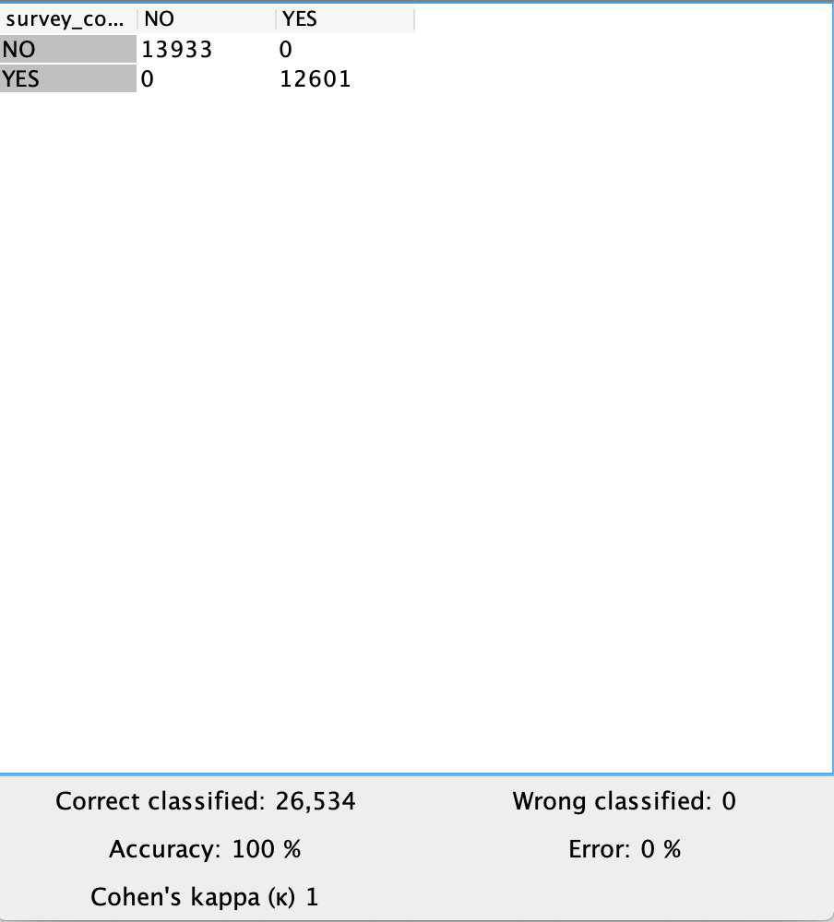
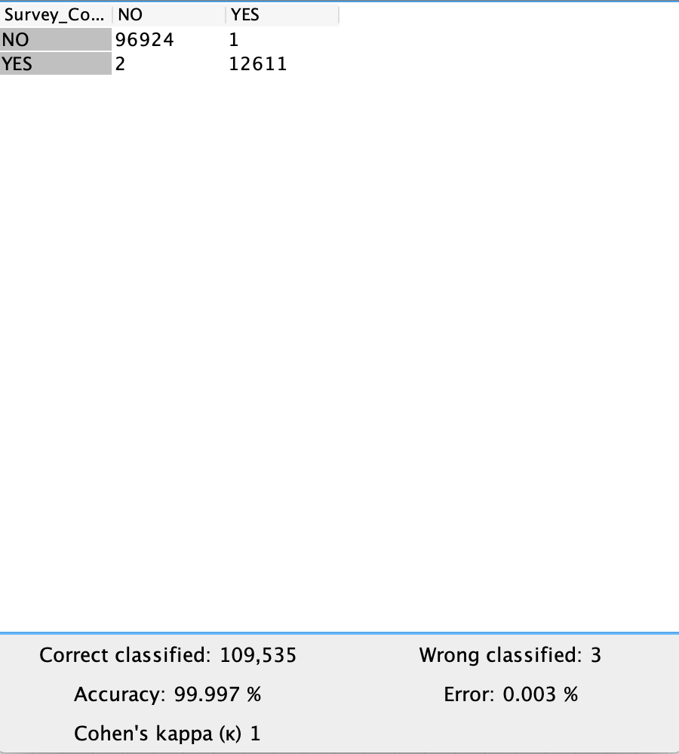
Datasets
The “Salesforce_Survey_Demographics.xlsx” and “Feedback_c.csv” spreadsheets were used and combined using the “Id” column as the primary key.
Surveys Complete
Surveys Complete_No Race
Notes:
The decision tree models show that null responses within the race column have minimal effect on the accuracy of the prediction. However, it does have enough of an effect to throw the model off slightly.

Slide 6
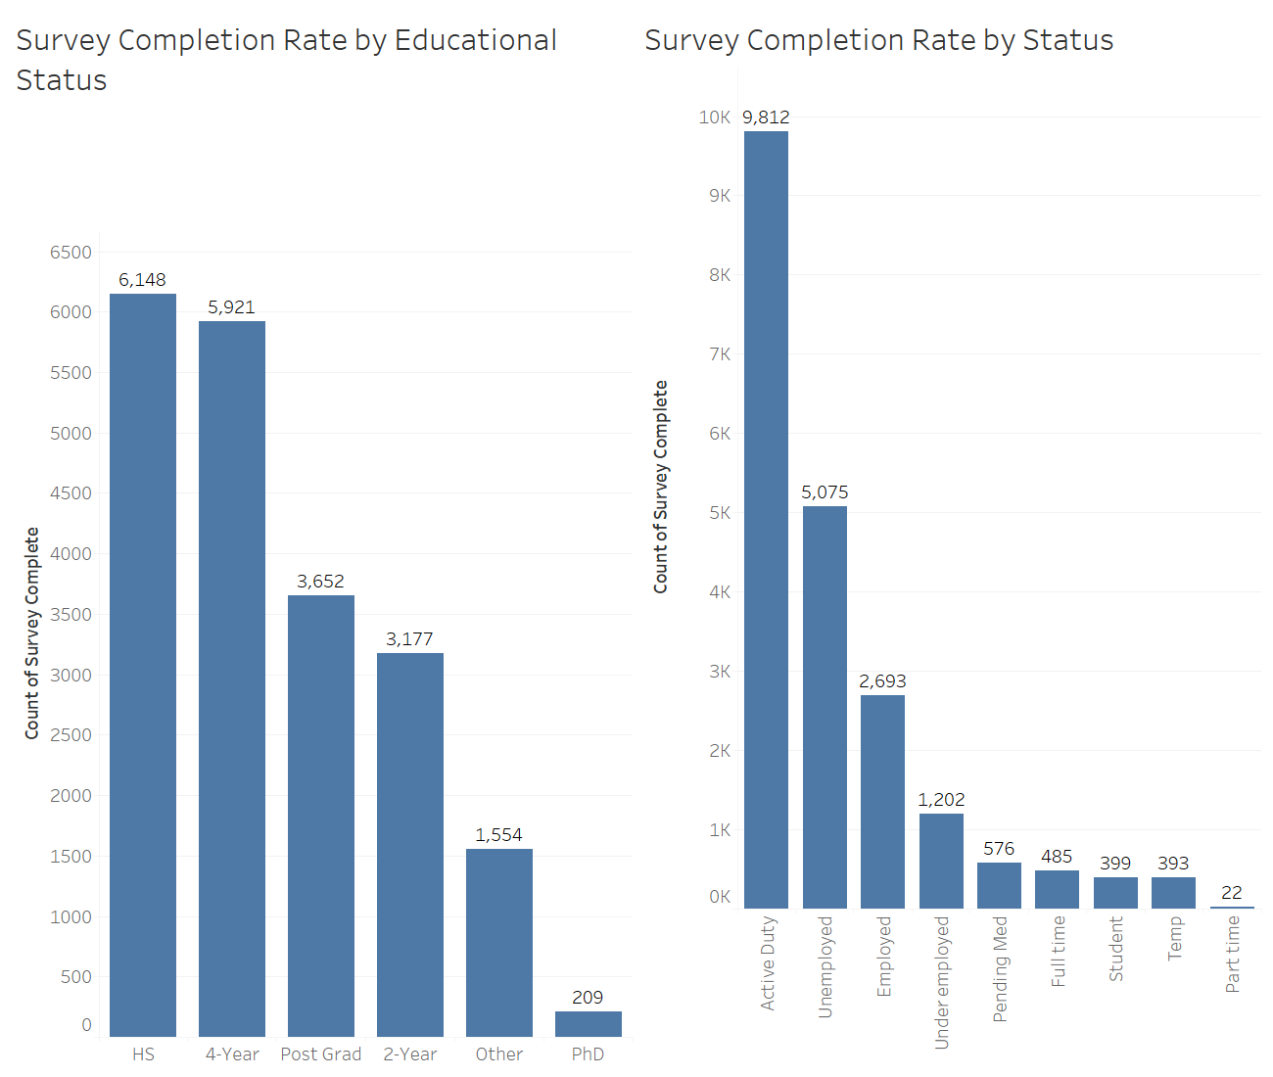

Slide 7
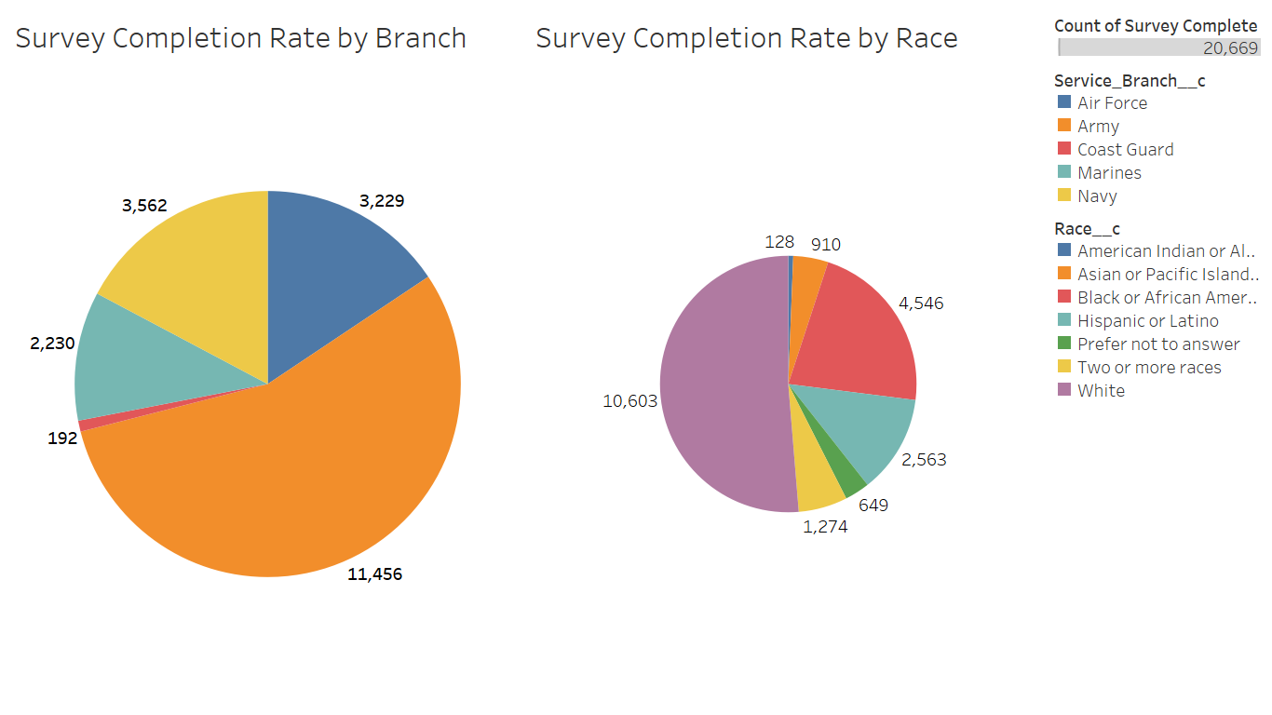

Slide 8
Results
In the Education category we see an increase in surveys taken by those with their highest education being either HS or 4-Year Degrees.
In the Employment Status category, Active Duty and Unemployed individuals are those who have completed the most surveys.
In the Service Branch category, we see the majority of the surveys being taken from those in the Army and Navy.
In the Race category, White and Black or African American have the highest survey completion rate among the different races.
Notes:
We believe this is due to members leaving service and still utilizing military benefits and veterans targeted tools. Those who pursue higher education than the standard 4-years are likely networking and utilizing services more focused on their speciality.
Active Duty individuals most likely have a higher completion rate, because they will likely be getting out of the military soon and are actively looking for jobs.
Army & Navy has a much higher percentage serving than the other branches, so statistically there is a higher amount being discharged on average.
Whites and blacks also make up the highest percentages of the military, so it makes sense for more veterans to fit this demographic and use the HireHeroes service.

